Slide 1

Notes:
Welcome to lesson 3 of The Bible 101.
Make sure everyone has their notes sheet, pen, and Bible.
Open with prayer:
Father, we thank you for the opportunity to study your Word today. Our hearts are open and our minds are alert. We humbly ask you to open our eyes that we may understand the message you have sent to us, and give us a heart to obey it to the best of our ability. In Jesus’ name we pray, amen.
Thought: If the Bible is really God’s Word….
Than what can be more important than studying it, understanding it, and obeying it?
Nothing!

Slide 2
Overview
Lesson 1
Lesson 2
Lesson 3
Lesson 4
The
Problem
The
Plan
The
Solution
The
Journey
Notes:
Overview of The Bible 101 course:
Lesson 1: The Problem. Why do we need saved? (Genesis)
Lesson 2: The Plan: God reveals His plan to save us through the ancient nation of Israel. (Exodus- Malachi)
Lesson 3: The Solution: God sends His Son, Jesus Christ, to solve the sin problem. (Matthew - Acts)
Lesson 4: The Journey: Living the Christian life. (Romans - Revelation)

Slide 3
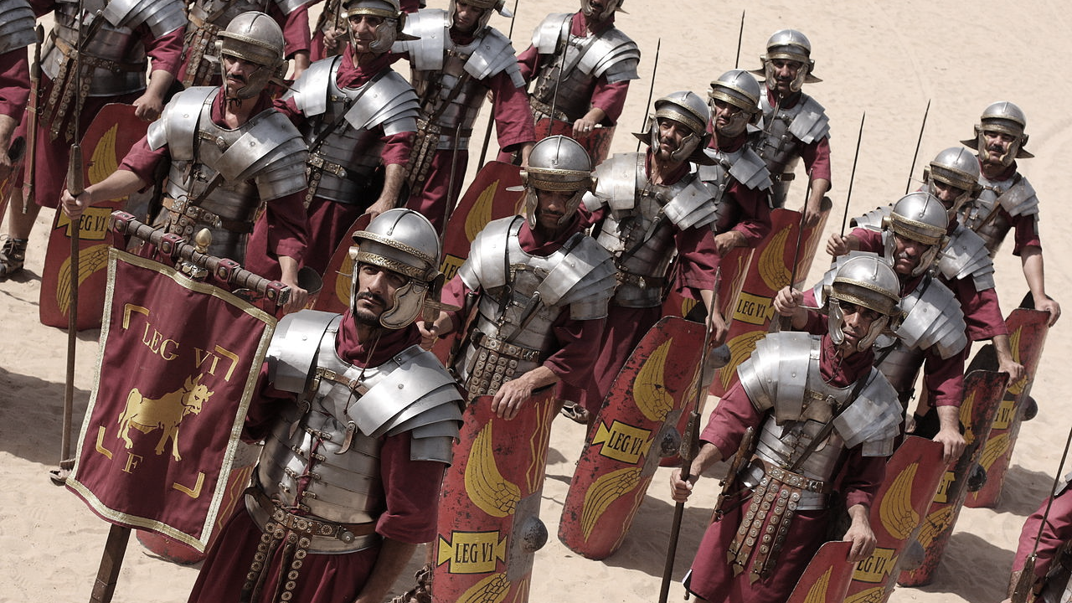
Notes:
Let’s review last weeks lesson:
Through Moses, God delivered Israel out of bondage in Egypt.
God gave Moses the Law at Mount Sinai.
Joshua led Israel to conquer the Promised Land.
Israel broke the covenant by worshipping idols.
God’s was faithful to bring them back from captivity.
This is the scenario at the time of Christ:
Herod is king over Israel.
Israel is under Roman rule. (Pontius Pilate was governor)
The Romans collected taxes and enforced order and loyalty to the Emperor.
Israel is anxiously awaiting the Messiah to come and free them from Roman rule.

Slide 4

The Gospels are four different accounts of the life and ministry of Jesus Christ.
Notes:
The Gospels are four different accounts of the life and ministry of Jesus Christ.
The Gospels are the first four books of the New Testament. (Matthew, Mark, Luke, John)
They each tell about Jesus’ life and ministry from a different point of view.
They are repetitive.
Jesus’ ministry lasted about 3.5 years
Each Gospel has a different focus:
Matthew - Written by tax collector and disciple Matthew
Shows Jesus as the Jewish Messiah.
Mark - Written by Mark, a close associate of Peter
Shows Jesus as a suffering servant.
Luke - Written by Luke, a doctor and companion of the Apostle Paul
Shows Jesus as a human being. (Son of Man)
John - Written by John the disciple.
Shows the divinity of Jesus. (Son of God)

Slide 5

Mary was a virgin who was impregnated by the Holy Spirit with a child.
Notes:
How was Jesus born?
The Christmas story is very familiar to us.
Mary was a virgin who was impregnated by the Holy Spirit with a child.
Joseph was upset because he was not the father
An angel appeared to Joseph to reassure him
READ: Matthew 1:20-21 (35)
Born in Bethlehem with many signs and wonders.
They were warned by an angel to flee to Egypt to avoid being killed.
Later they returned to city of Nazareth to live.
Jesus’ cousin was John the Baptist.

Slide 6
John the Baptist was a prophet and his purpose was to prepare the way for Jesus’ ministry.
Notes:
John the Baptist was a prophet and his purpose was to prepare the way for Jesus’ ministry.
John was the link between Old and New Testament.
Unusual man, lived in wilderness, ate unusual food.
Baptized followers and preached repentance.
John recognized Jesus as Messiah:
John 1:29 says: The next day John saw Jesus coming toward him and said, “Look! The Lamb of God who takes away the sin of the world!”
John baptized Jesus in the Jordan River.
Why was Jesus baptized? (Matt 3:15 “Let it be so for now, for thus it is fitting to fulfill all righteousness…”

Slide 7
Jesus began His ministry with forty days of fasting and prayer and was tempted by the devil.
Notes:
Jesus began His ministry with forty days of fasting and prayer and was tempted by the devil.
After baptism, Jesus was led by the Spirit into the wilderness for 40 days.
Satan tempted Jesus to sin three times.
This reminds us of the Israelites who wandered in the wilderness 40 years after crossing the Red Sea. (baptism)
Here is the pattern: After repenting and being baptized, our faith will be tested.

Slide 8
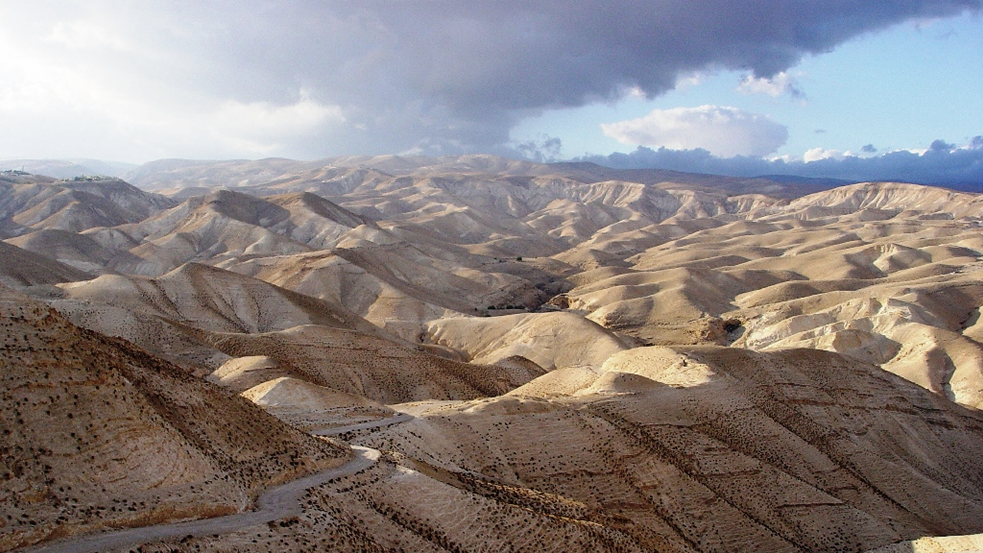
Notes:
This is a picture of the Judean wilderness in Israel that Jesus prayed and fasted in.
That’s why we must pray and fast:
Fasting helps us draw closer to God by denying our physical bodies.
Fasting is a sacrifice of something valuable to God.
Fasting releases spiritual breakthrough. (not instantly)
It makes us more effective in the Kingdom of God.
After Jesus was tested, he was ready for ministry.
What did Jesus do in His ministry?

Slide 9
Jesus’ ministry consisted of teaching, healing, and performing miracles.
Notes:
Jesus’ ministry consisted of teaching, healing, and performing miracles.
Matthew 4:23 says:
Jesus traveled throughout the region of Galilee, teaching in the synagogues and announcing the Good News about the Kingdom. And he healed every kind of disease and illness.
Jesus healed many people.
Trained the 12 disciples for leadership.
Opposed by religious leaders. (Pharisees)
Why? They didn’t understand who Jesus was.
They were expecting the Messiah to come in glory and military power, not humbly as a teacher.
Who was Jesus?

Slide 10
Jesus Christ was God manifested as a human being.
Notes:
Jesus Christ was God manifested as a human being.
This is why we refer to Him as the Son of God.
Proof:
Performed miracles. (numerous)
Controlled nature. (Mark 4:39)
Never sinned. (1 John 3:5)
Made statements only God could make. (John 10:33)
Forgave sins. (Mark 2:5-10)
Accepted worship. (John 9:38)
Fulfilled prophecies of the Messiah.
Rose from dead and ascended to Heaven. (Acts 1:9-11)
He was God in a physical body like ours.
Read: Matthew 16:13-17 and 26:63-64 (37)
Matthew 1:23 calls Him Emmanuel, meaning “God with us.”
So we know who Jesus is, why did He come?

Slide 11
Jesus’ primary mission in life was to die for our sins.
Notes:
Jesus’ primary mission in life was to die for our sins.
This would be the final solution to the sin problem from Adam.
(Explain how this was revealed in the Passover in Lesson 2)
Jesus became the final Passover Lamb.
Jesus’ death gave Him the right to save human beings from judgment and death.
God found a way to save us without violating righteousness and justice.

Slide 12
God poured out all the punishment for our sin and shame on Jesus.
Notes:
God poured out all the punishment for our sin and shame on Jesus.
Jesus endured tremendous pain and suffering for us.
He was beaten viciously.
Nailed to a wooden cross by hand and foot.
Perhaps the most excruciating, shameful death conceivable…

Slide 13
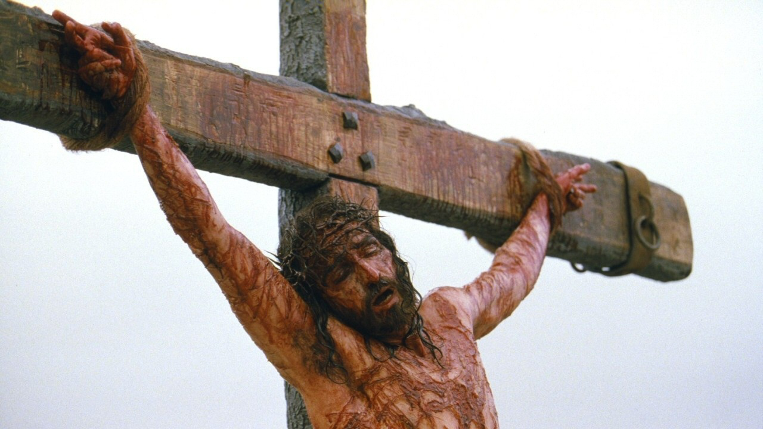
Notes:
The Romans used the crucifixion to execute criminals and terrorize the people.
Prophesied in detail by the prophet Isaiah.
READ: Isaiah 52:13 – 15 and all of chapter 53
On the cross Jesus gave forgiveness to those who crucified Him:
He said “Father, forgive them for they know not what they do.”
Jesus cried with a loud voice “My God, my God, why have you forsaken me?”
He was quoting Psalm 22. (READ: Psalm 22:1-18)
He gave up His spirit and died.
This is the single most important act that has ever taken place in history.
Why would God do all this for you and me?

Slide 14
God wanted to save us because He loves us.
Notes:
God wanted to save us because He loves us.
Love is the chief characteristic of God.
READ: John 3:16, Romans 5:8, 1 John 4:8 (38)
God is the perfect balance of love and justice.
The justice of God requires punishment for sin.
The love of God sent His Son to die for our sins.
God loves every human being regardless of what they have done.
READ: Ephesians 3:14-19 (39)

Slide 15
Jesus’ death on the cross gave Him authority over death and the grave.
Notes:
But that’s not all…
Jesus’ death on the cross gave Him authority over death and the grave.
Jesus broke the curse of sin and death from Adam.
After 3 days, Jesus rose from the dead. (explain)
Appeared to over 500 people at one time. (1 Cor 15:16)
Jesus appeared to His disciples and gave them final instructions.
To wait for a special baptism of the Holy Spirit.
To establish the church by making disciples.
Jesus sacrifice for sin does not automatically apply to everyone…

Slide 16
In order for Christ’s sacrifice to apply to us, we must be born again.
Notes:
In order for Christ’s sacrifice to apply to us, we must be born again.
Read: John 3:3-6 (40)
Being born again puts us in a new family.
We are no longer Adams seed.
We belong to Christ.
How do you get born again?

Slide 17
Being born again is a process of repentance, baptism, and being filled with the Holy Spirit.
Notes:
Being born again is a process of repentance, baptism, and being filled with the Holy Spirit.
READ: Acts 2:36-38 (40)
Repent: Change your mind. “I’m going to do it God’s way.”
Baptism: Immersion in water, calling on name of the Lord.
Holy Spirit: A spiritual gift that gives you power to overcome.
Tongues were often associated with the Holy Spirit filling in Acts.
Millions have experienced this infilling.
What about people who haven’t done this?
Some people disagree about what you need to do to be saved.
It’s not our job to judge others, but to obey the word of God.
Christ is the focus, not a formula.
God gave us a map, we should follow it.

Slide 18
When we are born again, our spirit is no longer dead, but alive spiritually because we belong to Christ.
Notes:
When we are born again, our spirit is no longer dead, but alive spiritually because we belong to Christ.
Remember, how we died spiritually when Adam sinned?
When we are born again, that spirit is reconnected and restored to right standing with God.

Slide 19
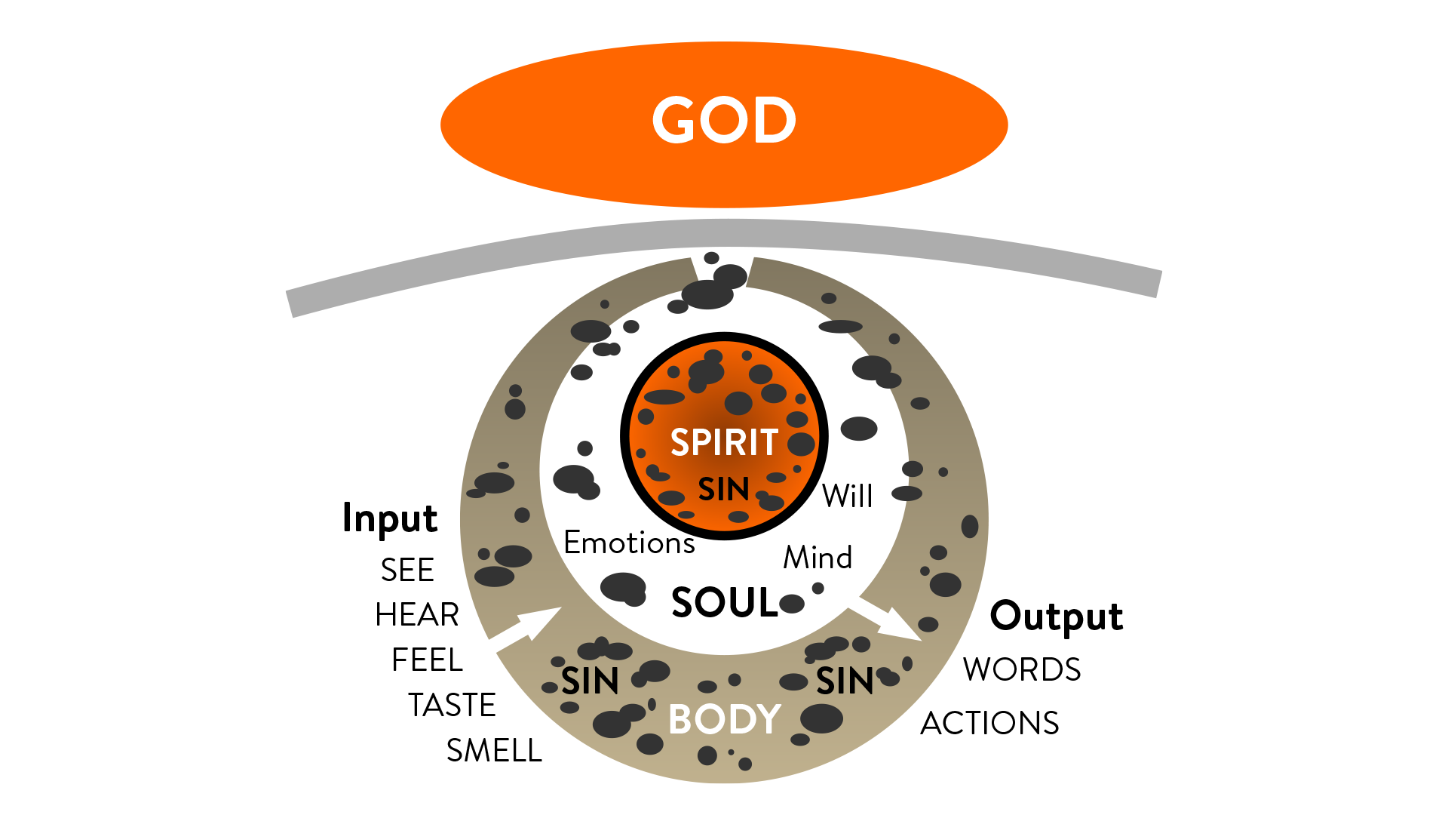
Notes:
This diagram depicts fallen, sinful man or woman:
We are separated, alienated from God.
Our body is the master.
We cannot perceive the Spirit.

Slide 20
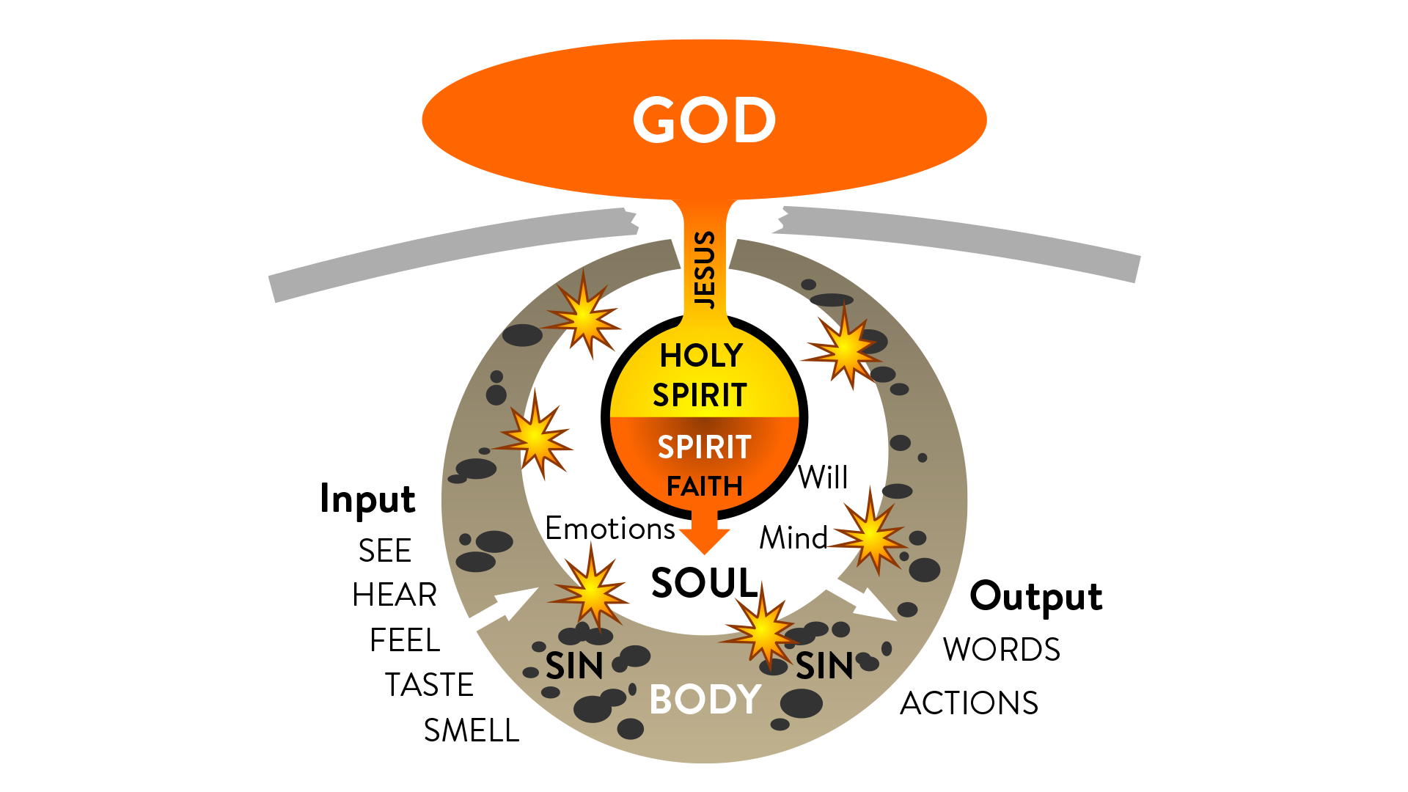
Notes:
This diagram depicts a born again man or woman:
Our spirit alive and connected to God through the Holy Spirit.
Flesh is still sinful, but the spirit fights against it.
The soul is a war zone between the spirit and body.
Bible reading, prayer, and worship activate faith.

Slide 21
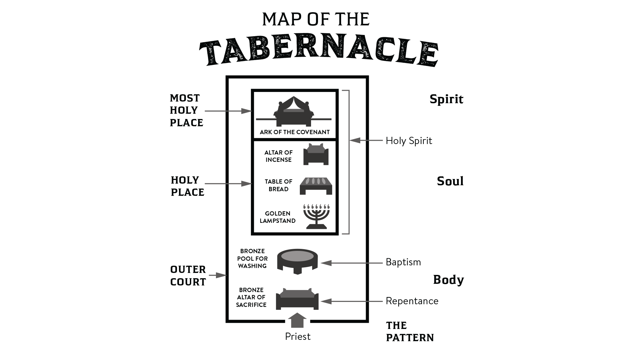
Notes:
Remember the tabernacle plan?
Here’s how it relates to salvation:
Body: The outer court. (Repentance and baptism)
Soul: The Holy place. (The Bible, prayer, and the Holy Spirit)
Spirit: The Most Holy Place. (The Holy Spirit)
If you have not been born again, you need to prayerfully consider doing so after this Bible study if you believe this message.

Slide 22
The church is a community of believers working together to build the Kingdom of God.
Notes:
What happens after you are born again?
You become part of the church.
Not just a local church, THE church.
The church is a community of believers working together to build the Kingdom of God.
READ: Acts 2:42-47 (41)
The church started in Jerusalem with mostly Jewish believers.
How did it end up spreading all around the world?

Slide 23
Persecution forced the early Christians to spread out all over the world and share the Gospel.
Notes:
Persecution forced the early Christians to spread out all over the world and share the Gospel.
Religious Jews persecuted the Christians.
The Gospel was spread to other nations by Apostles and missionaries.
A Pharisee named Paul persecuted the church very badly. (explain)
Then something amazing happened…

Slide 24
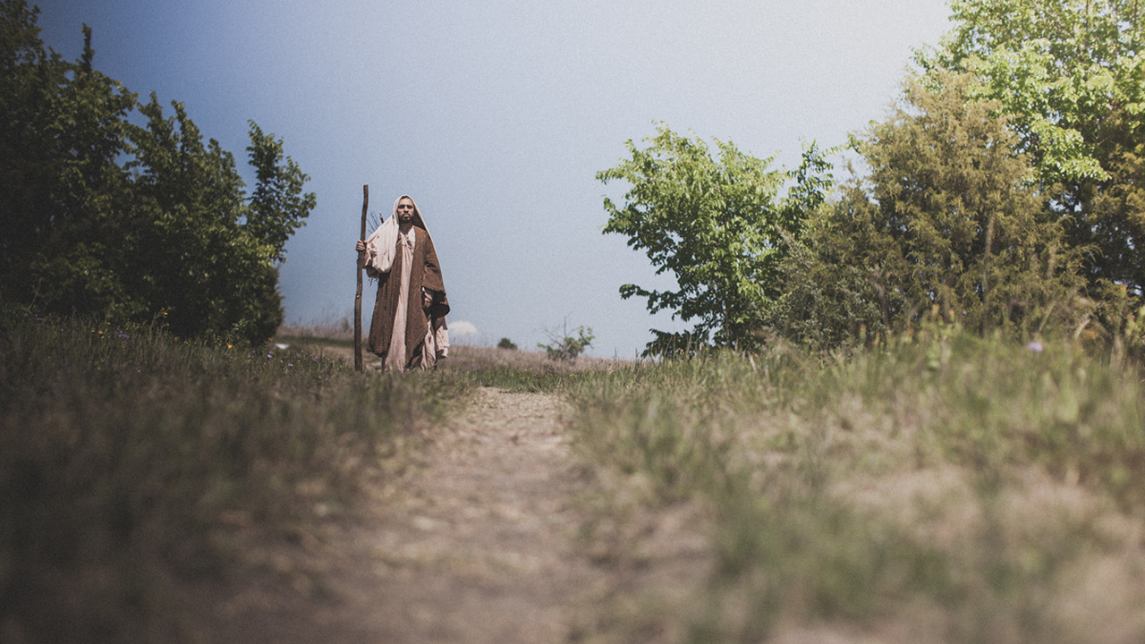
Notes:
On the road to Damascus, Christ revealed Himself to Paul in a vision.
Paul became a Christian.
Became an Apostle to the gentiles
14 of the 27 books of the new testament written by Paul.
In today’s lesson we covered:
The 4 Gospels that tell the story of Jesus’ life.
The birth, life, death, and resurrection of Jesus Christ.
How to be born again into the Kingdom of God.

Slide 25
Notes:
Questions or comments?
Ask each student to do the following before the next lesson:
Read Lesson 3 in the book again.
Spend 30 minutes alone praying. Ask God to lead you and guide you on your quest to find truth.

