Slide 1
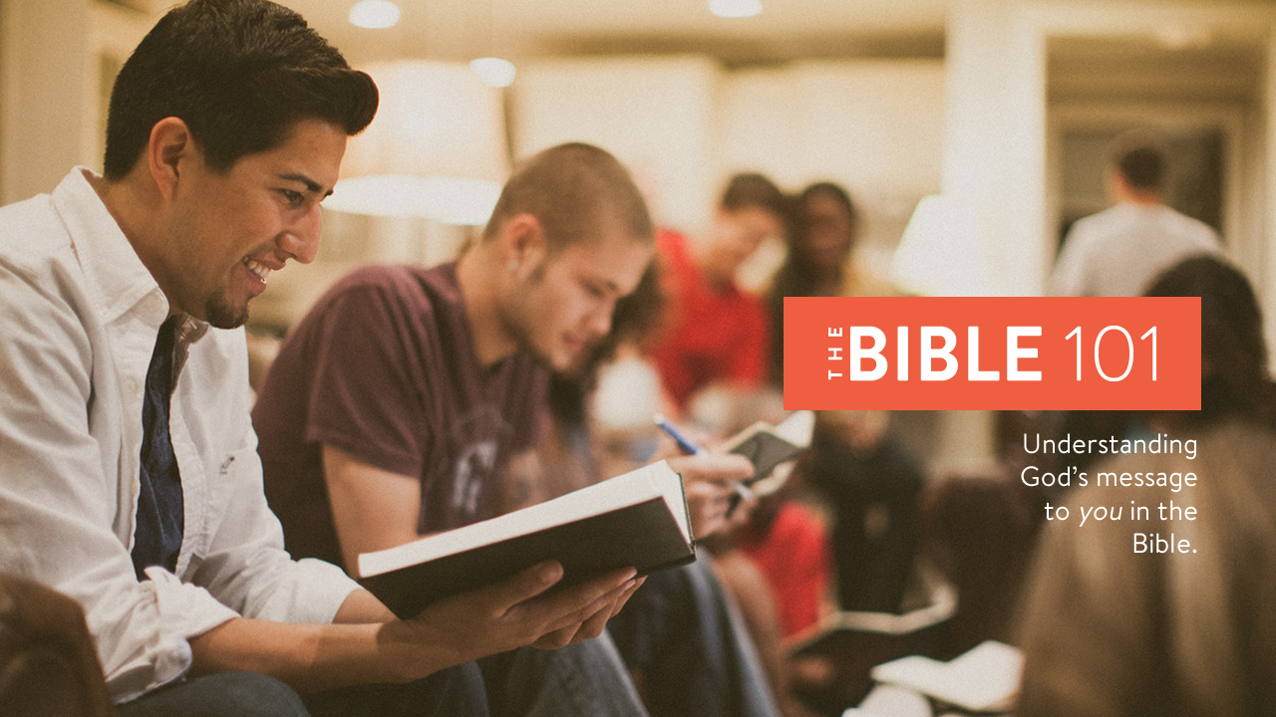
Notes:
Welcome to Lesson 2 of The Bible 101.
Make sure everyone has their notes sheet, pen, and Bible.
Open with prayer:
Father, we thank you for the opportunity to study your Word today. Our hearts are open and our minds are alert. We humbly ask you to open our eyes that we may understand the message you have sent to us, and give us a heart to obey it to the best of our ability. In Jesus’ name we pray, amen.

Slide 2
Overview
Lesson 1
Lesson 2
Lesson 3
Lesson 4
The
Problem
The
Plan
The
Solution
The
Journey
Notes:
Overview of The Bible 101 course:
Lesson 1: The Problem. Why do we need saved? (Genesis)
Lesson 2: The Plan: God reveals His plan through the ancient nation of Israel. (Exodus- Malachi)
Lesson 3: The Solution: God sends His Son, Jesus Christ, to solve the sin problem. (Matthew - Acts)
Lesson 4: The Journey: Living the Christian life. (Romans – Revelation)

Slide 3
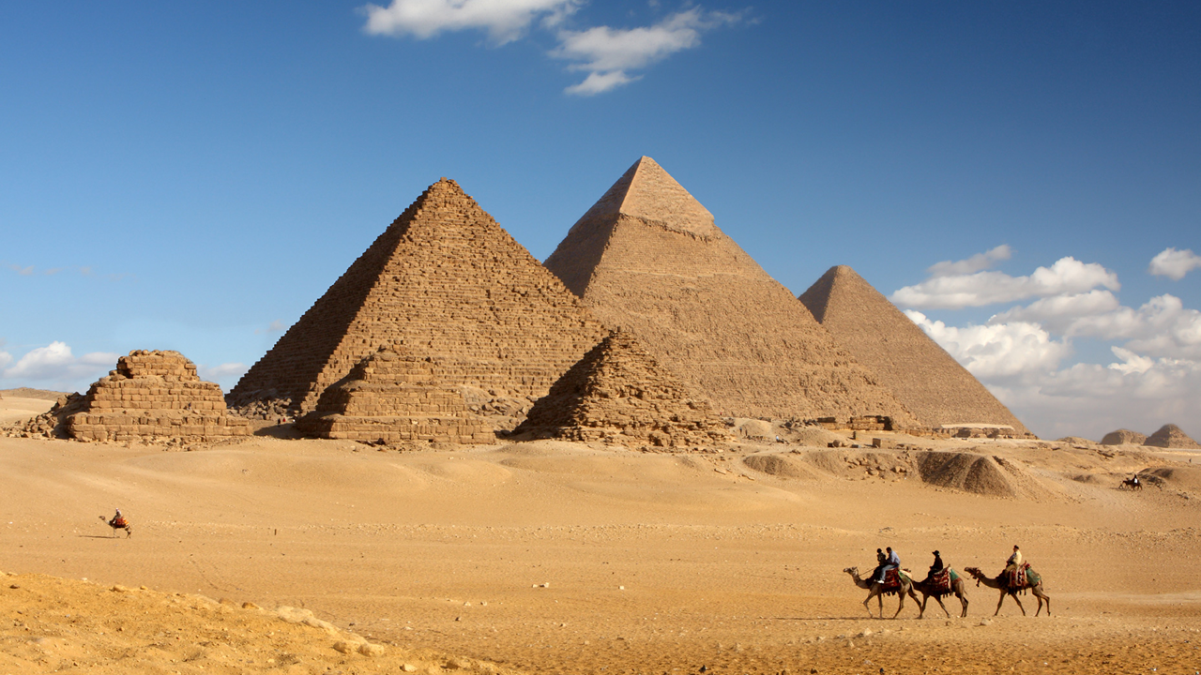
Review
Notes:
Let’s review what we learned last week:
We looked at the four witnesses of God’s existence: nature, testimony, the Bible, and the nation of Israel
Facts about the Bibles authenticity.
Sin is the reason that we need a Savior.
Faith is the first step to please God. (Abraham)
How Israel ended up in Egypt. (Joseph)

Slide 4

The journey of Israel from Egypt to the Promised Land is a pattern for our salvation.
Notes:
Explain the situation in Egypt:
215 years later.
Joseph and brothers are gone.
Israel grows to 2 million+ people.
Slaves to the Egyptians.
God sent Moses to lead them back to the Promised Land.
Moses was the great-grandson of Levi, Joseph’s brother.
The journey of Israel from Egypt to the Promised Land is a pattern for our salvation.

Slide 5

Leaving Egypt is a picture of repentance which means to change your thinking.
Notes:
Explain the story of Moses.
Ten plagues.
Death of firstborn.
Explain the Passover as a type of Christ.
The blood of the lamb applied to the doorpost protected them.
READ: 1 Corinthians 5:7 (pg. 23)
Israel left Egypt the night of Passover.
Egypt represents SIN and the worldly system.
Leaving Egypt is a picture of repentance which means to change your thinking.
Explain how God is calling us to come out of this sinful world, and follow Him.

Slide 6
The Red Sea crossing is a picture of baptism.
Notes:
Explain what happened when they left:
Trapped in by the desert and the Red Sea.
Egyptian army pursues.
God parts the waters.
Egyptian army drowned.
The Red Sea crossing is a picture of baptism.
Our sins are washed away.
We are now FREE from the bondage and slavery of sin.

Slide 7
The wilderness journey is a picture of our life on Earth as Christians.
Notes:
Explain what happened after the crossing:
They were free, but not in the Promised Land yet.
Their faith was tested. (story of the spies)
They failed the “faith” test.
Wandered In wilderness for 40 more years.
All adult men died. (Except Caleb and Joshua)
The wilderness journey is a picture of our life on Earth as Christians.
Life is difficult in the wilderness.
Our faith is tested by trials and suffering.
We must learn to put our trust in God.

Slide 8
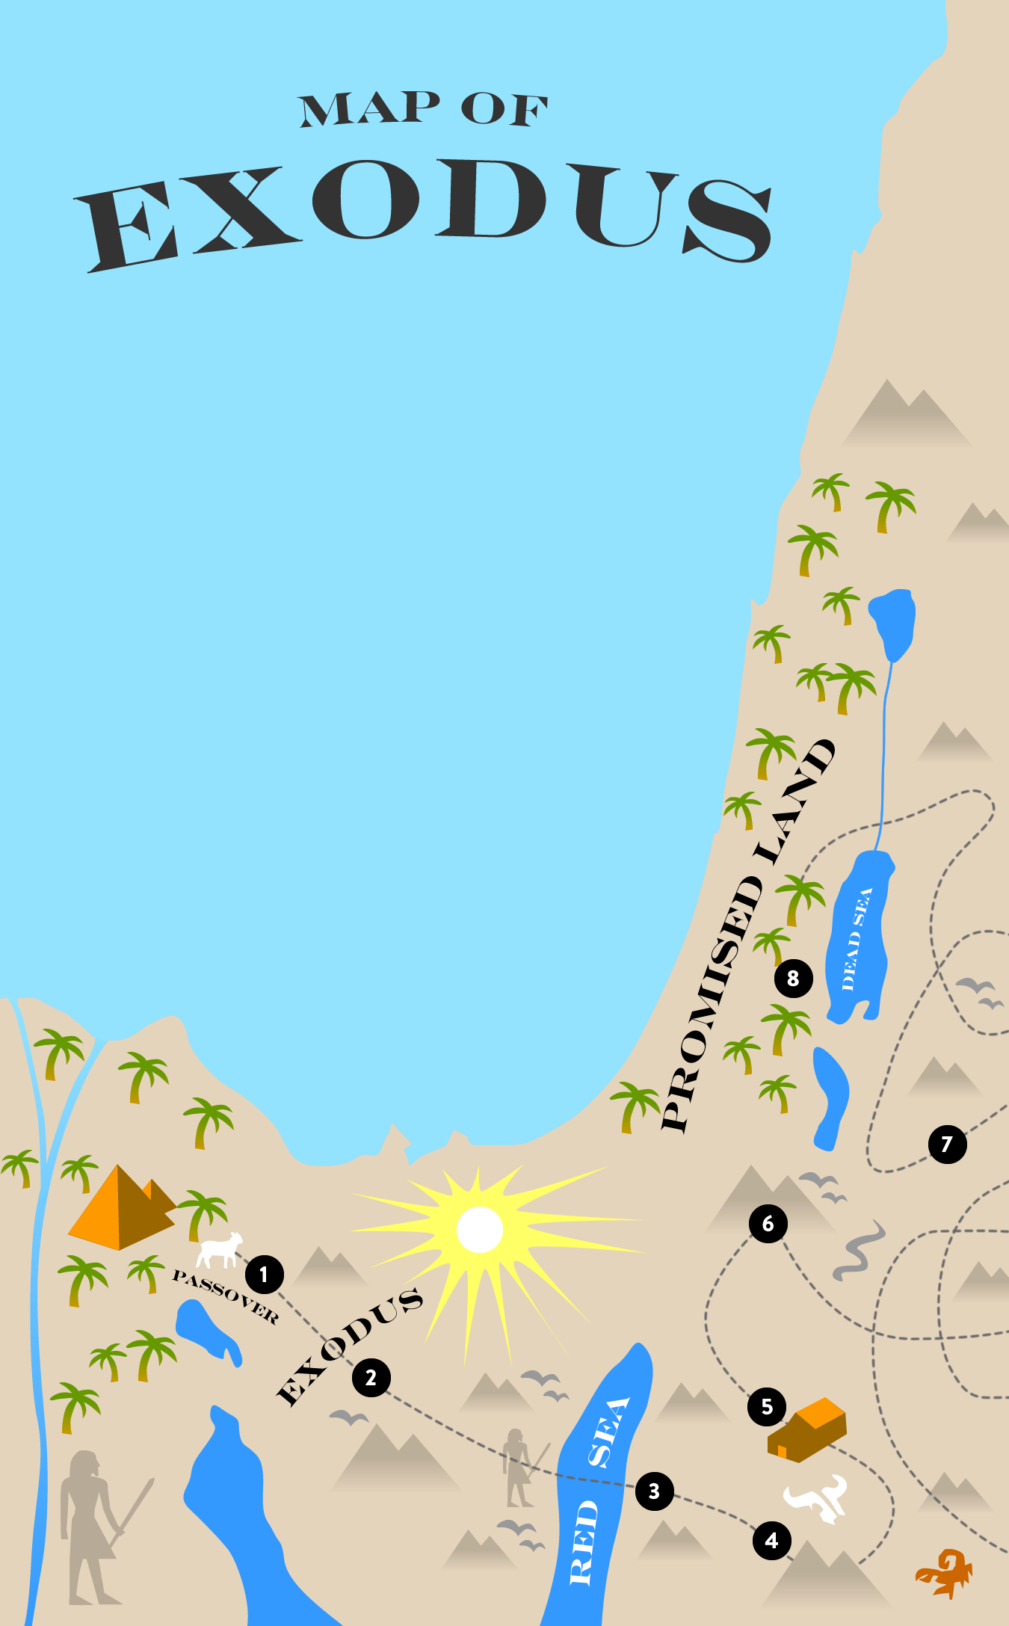
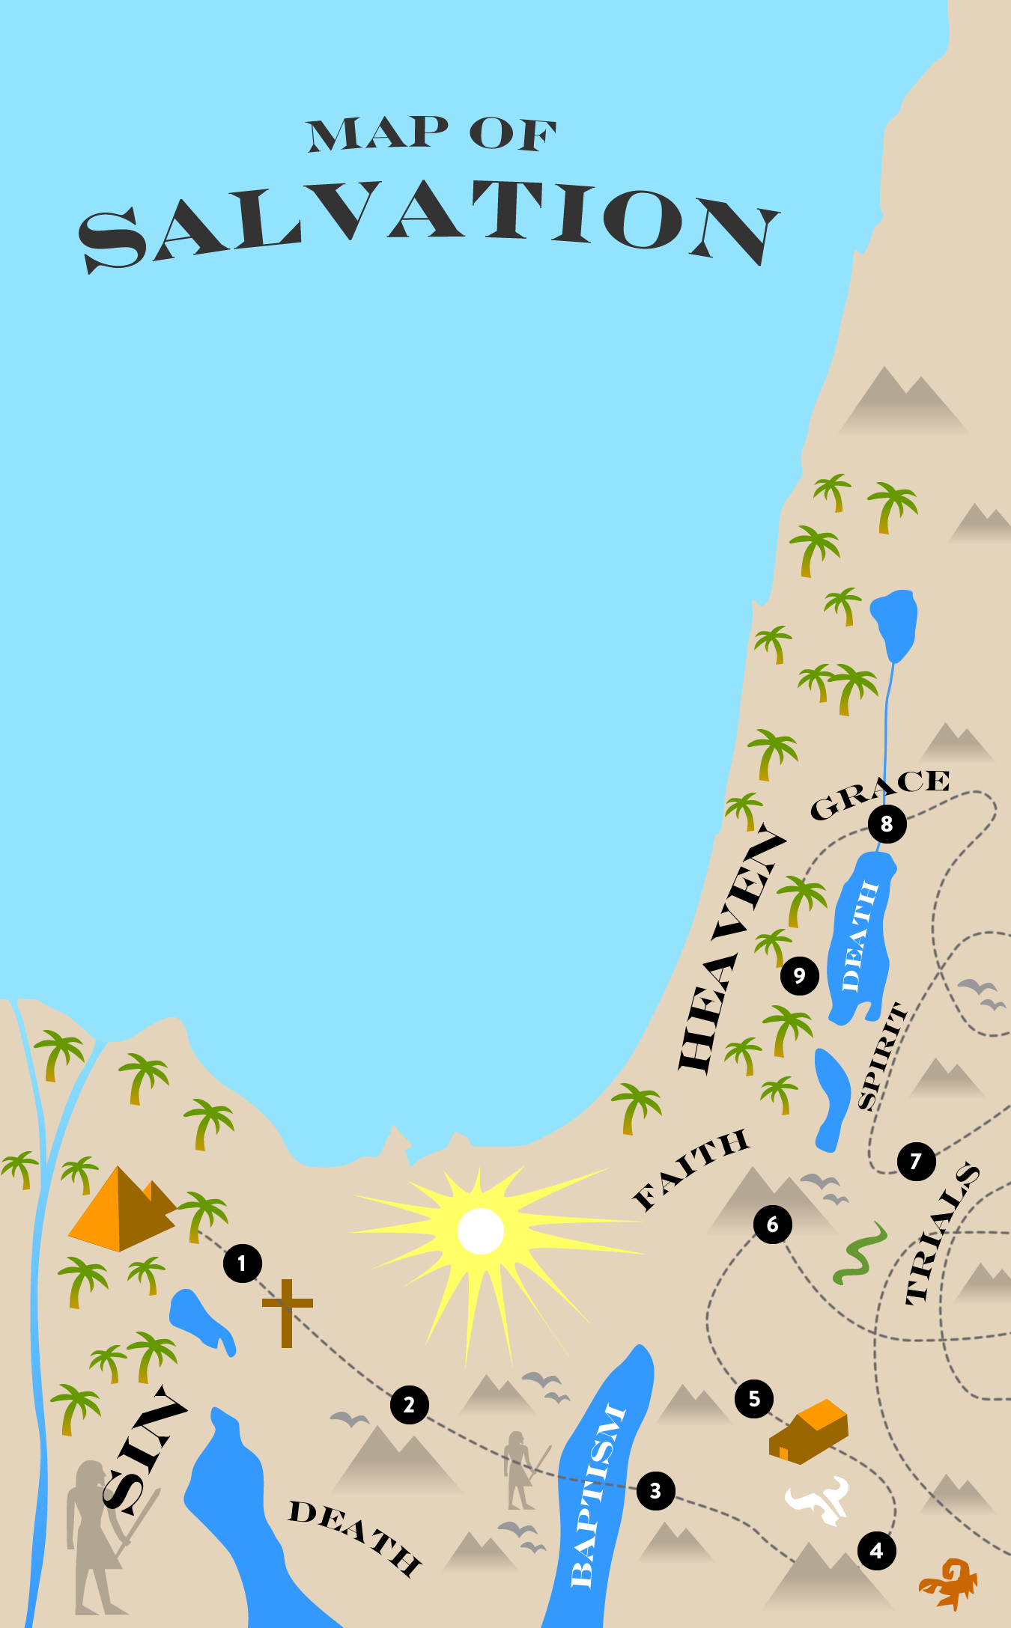
Notes:
Explain these two maps and how they relate.
For us, the Promised Land is Heaven.
In many ways, we can enter into the Promise Land in this life when we learn God’s Word and obey it. (Kingdom principles)
God is the King in the Promised Land of Heaven.
God’s Kingdom comes when we do His will here on Earth.

Slide 9
The Law was God’s expanded covenant with the nation of Israel.
Notes:
An important thing happened in the wilderness:
Moses was given instructions at Mount Sinai.
The Law, the first five books of the Bible. (Jews call it the Torah)
Contained the tabernacle plan, offerings, festivals, laws, punishment, etc.
The Law was God’s expanded covenant with the nation of Israel.
The righteous nation of Israel would be an example to the nations of the world.
Idol worship was sinful and widespread in other nations.

Slide 10
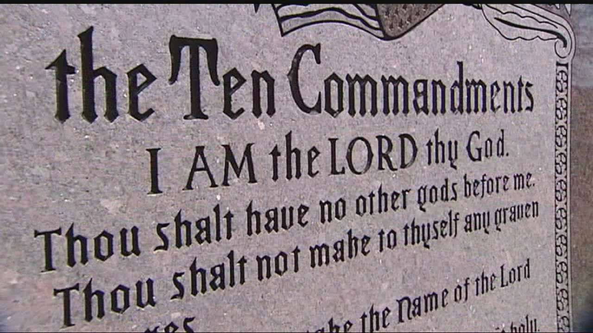
Notes:
I want to pause here and explain something:
A common attack on Christianity is to point out some cruel or harsh verses from the Mosaic Law in order to discredit the entire Bible.
They may ask: “Do you believe in stoning someone caught in adultery?” (No)
3 Types of law:
Religious Law (worship, temple sacrifices, ritual purity)
Moral Law (personal conduct, murder stealing)
Civil Law (community, property, speeding ticket)
Laws were combined into one without separation and distinction. Punishment was enforced locally.
Don’t be confused that Christians do not keep the Law of Moses.
The New Testament helps us understand what was fulfilled by Christ and what we still need to keep in the New Covenant.

Slide 11
The tabernacle was a portable temple that contained God’s pattern for salvation: death, burial, and resurrection.
Notes:
A very important part of the Law was the Tabernacle in the Wilderness.
The tabernacle was a portable temple that contained God’s pattern for salvation: death, burial, and resurrection.
The Tabernacle was a focal point of worship and provided a place for people to offer sacrifices and offerings to God.
The tribe of Levi had the special task of serving and administrating the activities in the tabernacle.

Slide 12
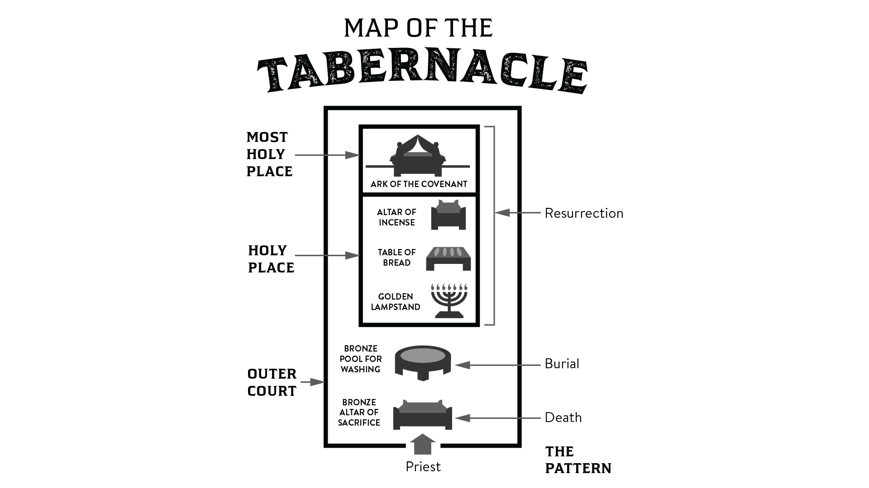
Notes:
Explain the tabernacle layout and how it relates to the Exodus:
Altar of sacrifice (Death – Passover)
Pool of water (Burial – Red Sea)
Holy Place (Resurrection – Shade, food, light)
Most Holy Place (Covenant – Atonement)
Later in this study, we will learn how this pattern relates to our salvation and daily walk with God.
Explain the day of Atonement
Only a temporary solution
Pointed to Christ, the final sacrifice for sin
READ: Hebrews 10:1-18 (not in book)

Slide 13
In the Promised Land, Israel was successful as long as they obeyed the terms of the Law.
Notes:
After 40 years in the wilderness, Israel was spiritually ready to enter the Promised Land.
The land was occupied by strong nations.
Joshua is the leader.
Joshua is a type of Christ. (explain)
In the Promised Land, Israel was successful as long as they obeyed the terms of the Law.
Victory at Jericho (obeyed Gods plan)
Defeat at Ai (Achan’s disobedience)
Willful disobedience leaves us, our family, and church vulnerable to Satan’s attack.
It is important that we read and obey God’s Word.

Slide 14
God sent Judges to defeat Israel’s enemies in the Promised Land.
Notes:
Israel was victorious and possessed the Promised Land.
They did not drive out the inhabitants.
Result: attacks and cultural influence.
Israel had no king, the Law and prophets governed.
Every man did what was “right in his own eyes.” Judges 21:25
Result: Tremendous oppression.
READ: Judges 2:1-3 (pg. 27)
God sent Judges to defeat Israel’s enemies in the Promised Land.
A Judge was almost like a super hero. (military/prophet hybrid)
Sampson and Gideon are the most well known Judges.
Israel demanded Samuel to give them a king.
Israel wanted to be like other nations. (imitating the world)

Slide 15
King Saul was a symbol of man’s rebellious nature.
Notes:
Saul became Israel’s first king.
He started out good, then went bad.
Saul did things his own way, not Gods way. (disobedient)
King Saul was a symbol of man’s rebellious nature.
He was tall and good looking, strong, everything you want in a king, but his heart was corrupt.
God looks on the heart, not the outer man. (1 Samuel 16:7)
The next king would be handpicked by God and would be a man “after God’s own heart.” (King David)

Slide 16
God gave King David tremendous power to defeat the enemies of Israel.
Notes:
God gave King David tremendous power to defeat the enemies of Israel.
Tell the story of King David:
He defeated Goliath. (You and God can defeat any giant)
He defeated enemies. (Jebusites, captured Jerusalem)
David was not perfect. (Story of Bathsheba)
David is also an example of grace. (God’s favor)
David sincerely repented and God forgave him.
We can also receive God’s mercy and forgiveness through grace.

Slide 17
King Solomon built the first temple in Jerusalem, replacing the tabernacle.
Notes:
David’s son, Solomon, became king when David died.
Solomon had great wealth and prestige.
He asked God for wisdom to judge right from wrong.
King Solomon built the first temple in Jerusalem, replacing the tabernacle.
A time of great peace and prosperity.
The golden age of Israel.

Slide 18
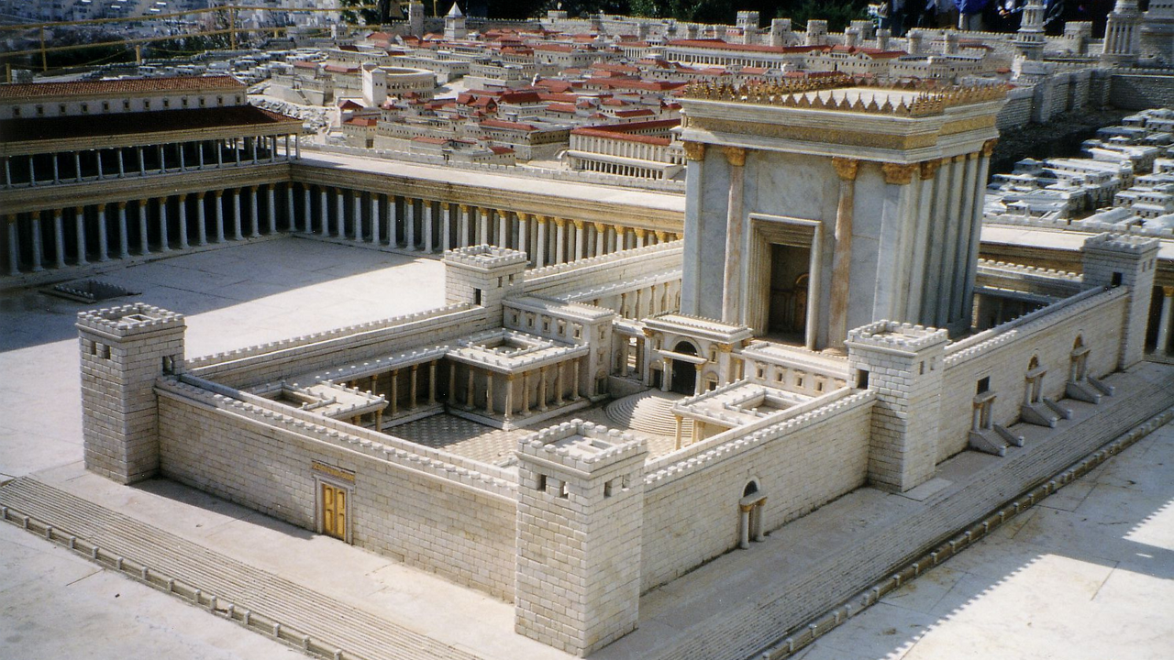
Notes:
What did the temple look like?
This is a model of the temple.
It was beautiful!
This is the place God chose for His name to be honored.
Many believe this is the original site where Abraham was going to offer Isaac.

Slide 19
Psalms is a book of lyrics that gives praise to God and describes the struggle between the righteous and the wicked.
Notes:
King David was highly skilled as a musician and songwriter.
Psalms is a book of lyrics that gives praise to God and describes the struggle between the righteous and the wicked.
David understood secret to spiritual victory: praise and worship.
Worship is an important part of our devotion.
Proverbs is a book of wisdom by Solomon.
Ecclesiastes is the search for the meaning of life.
READ: Eccl. 12:13-14 (pg. 29)

Slide 20
Israel began to worship idols and eventually split into two separate kingdoms.
Notes:
Israel began to decline as a nation:
Israel had wicked and righteous kings.
Idol worship was a big problem.
Today, idols can be anything we prioritize higher than God. (explain)
Thought: Where are we sacrificing our time, money, and energy?
Israel broke God’s covenant, the prophets warned of coming judgment
Israel began to worship idols and eventually split into two separate kingdoms.
Israel on the north (10 tribes)
Judah in the south (and Benjamin)

Slide 21
God punished Israel by allowing the Babylonians to destroy the Temple and take them into captivity.
Notes:
God punished Israel by allowing the Babylonians to destroy the Temple and take them into captivity.
Jerusalem and the Temple were destroyed.
The people were taken to Babylon in captivity.
Even in captivity, God protected His people:
Esther (saved the Jews from extermination)
Shadrach, Meshach, Abednego (saved from being burned alive)
Daniel (saved from lions, gave prophecies of the future)

Slide 22
After 70 years in Babylon, the Israelites returned and rebuilt Jerusalem and the Temple.
Notes:
After 70 years in Babylon, the Israelites returned and rebuilt Jerusalem and the Temple.
God used Nehemiah to rebuild the city.
The temple was rebuilt FIRST. (Zerubbabel oversee)
The job was difficult and dangerous.
There was opposition from other groups in the area.
This was the same temple that Jesus would walk in about 500 years later.

Slide 23
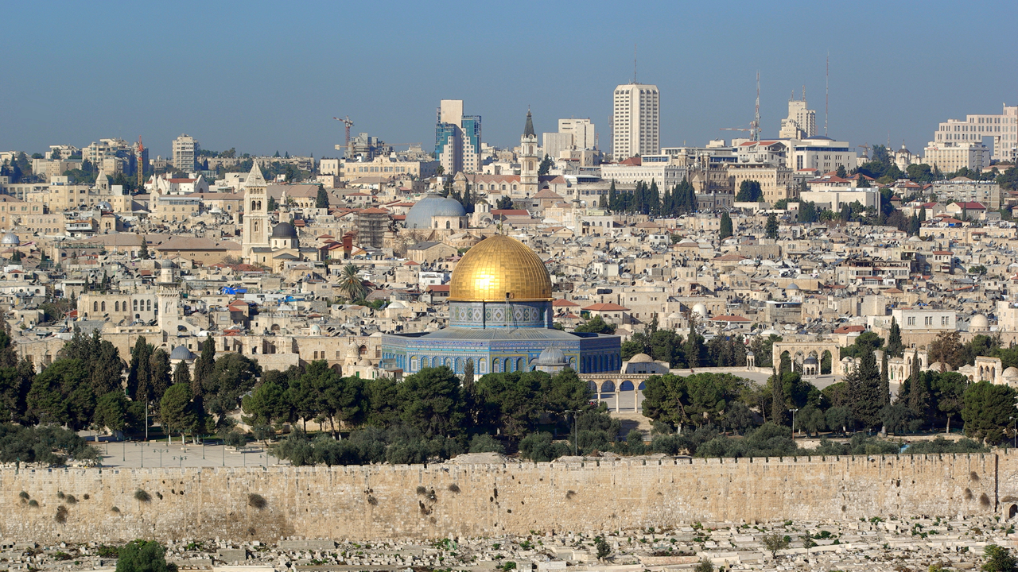
The Temple Mount in Jerusalem
Notes:
What about the temple mount today?
This is the epicenter of spiritual warfare in the world.
Explain the history of the Temple Mount:
Destroyed in 72 AD (Roman soldiers split the stones looking for gold that had melted in the cracks.)
Now occupied by 2 Muslim holy sites: the Al Aqsa Mosque, and Dome of the Rock. (explain)
Current situation: Under Jordanian security, Jews not allowed to pray.
The Western or “Wailing” wall. Explain that it is one of the few remaining structures of the second temple and is considered holy by the Jews.
Keep your eyes on the temple mount, it is key to endtime events.

Slide 24
The Law was not intended to be a permanent solution to the sin problem.
Notes:
Israel's struggle to keep the law was a great disappointment to God. Fortunately…
The Law was not intended to be a permanent solution to the sin problem.
Explain the limitations of the Law:
It was hard to keep.
It made people want to sin more.
It addressed the symptoms of sin, but not the cause (the heart)
People who were good at keeping the law thought they were superior to others. (Pharisees)

Slide 25
The Old Testament prophets predicted the coming of Jesus Christ.
Notes:
God’s permanent solution to the sin problem was still on the horizon: Jesus Christ.
The Old Testament prophets predicted the coming of Jesus Christ.
Matthew used these scriptures in the NT to prove Jesus was the messiah:
The virgin birth was prophesied by Isaiah. (Matthew 1:22-23)
Jesus birthplace was prophesied by the prophet Micah. (Matthew 2:5-6)
John the Baptist was prophesied by Isaiah. (Matthew 3:3)
Jesus’ home town of Nazareth was also prophesied by Isaiah. (Matthew 4:15-16)
The purpose of Jesus’ ministry was prophesied by Isaiah. (Isaiah 61:1-2 and Luke 4:17-21)

Slide 26
There is a period of 400 years of silence between the Old and New Testament.
Notes:
There is a period of 400 years of silence between the Old and New Testament.
No scripture was given.
The Persian empire was followed by the rise and fall of the Greek empire. (Alexander the Great)
After that, a new nation rose to rule the world:
The Roman Empire.

Slide 27
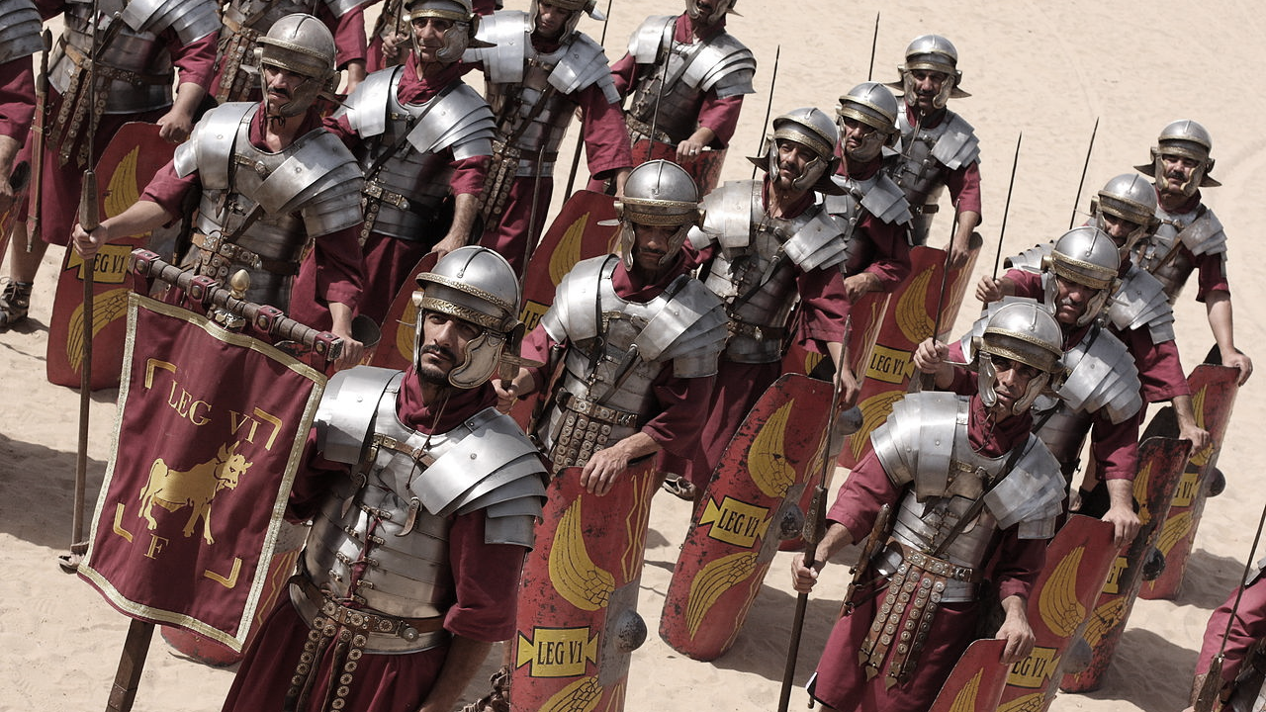
Notes:
This is the scenario at the time of Jesus’ birth:
Herod is king over Israel
Israel is under Roman rule (Pontius Pilate was governor)
The Romans collected taxes and enforced order and loyalty to the Emperor
Israel is anxiously awaiting the messiah to come and free them from Roman rule.
Let’s review today’s lesson:
God delivered Israel out of bondage in Egypt through Moses.
God gave Moses the Law at Mount Sinai.
Joshua led Israel to conquer the promise land.
Israel broke the covenant by worshipping idols.
God faithfully brought them back from captivity.

Slide 28
Notes:
Questions or comments?
Ask each student to do the following before the next lesson:
Read Lesson 2 in the book again.
Spend 30 minutes alone praying. Ask God to lead you and guide you on your quest to find truth.

