Slide 1
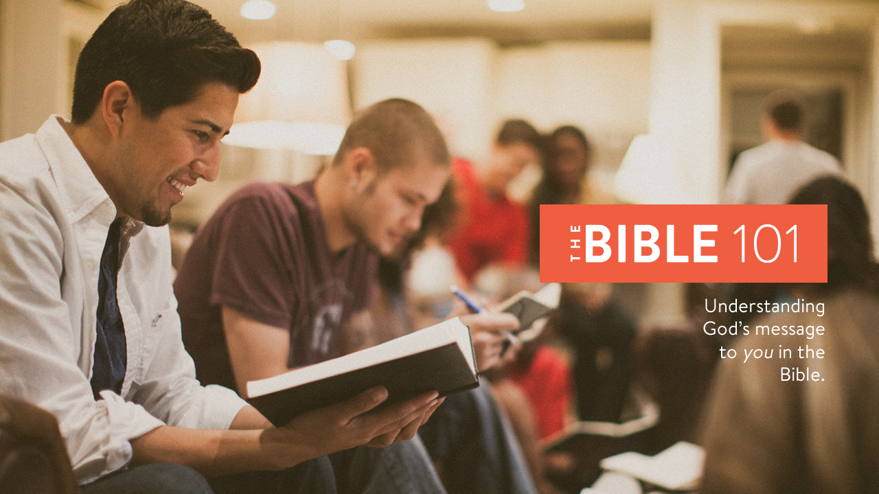
Notes:
Formally introduce yourself if needed.
Make sure everyone has their notes sheet, pen, and Bible.
Open with prayer:
Father, we thank you for the opportunity to study your Word today. Our hearts are open and our minds are alert. We humbly ask you to open our eyes that we may understand the message you have sent to us, and give us a heart to obey it to the best of our ability. In Jesus’ name we pray, amen.

Slide 2
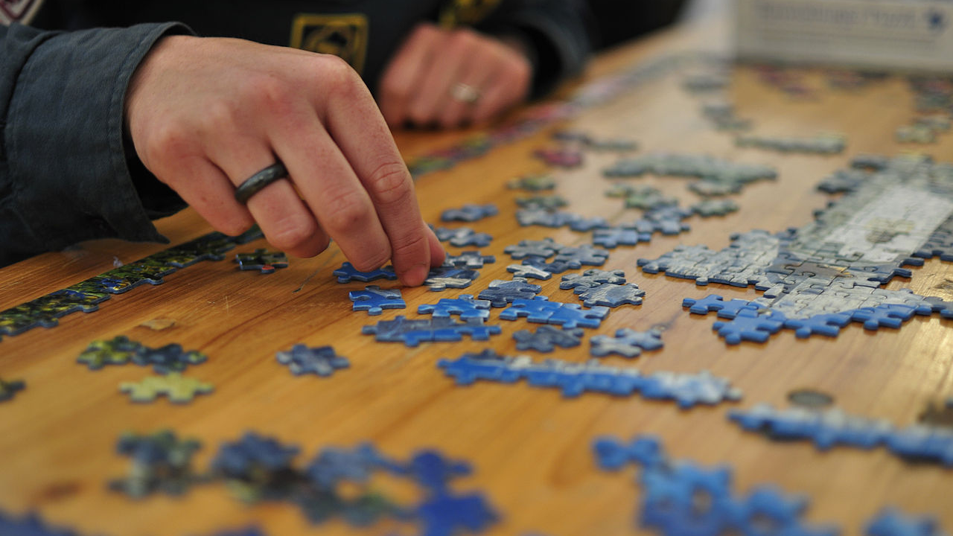
Notes:
Have you ever tried to put together a jigsaw puzzle without the picture on the front of the box?
What are the results? - Incomplete and disconnected pieces of the picture.
The Bible can be an intimidating book! (explain)
Many people piece together their understanding of God from random pieces of truth and teaching they pickup from preaching, conversations, television, and movies.
The result is incomplete and disconnected pieces of truth. (and some untruths)
This Bible study is designed to show you how the pieces of the puzzle fit together to form the “BIG PICTURE.”

Slide 3
Overview
Lesson 1
Lesson 2
Lesson 3
Lesson 4
The
Problem
The
Plan
The
Solution
The
Journey
Notes:
Overview of The Bible 101 course:
Lesson 1: The Problem. Why do we need saved? (Genesis)
Lesson 2: The Plan: God reveals His plan through the ancient nation of Israel. (Exodus- Malachi)
Lesson 3: The Solution: God sends His Son, Jesus Christ, to solve the sin problem. (Matthew - Acts)
Lesson 4: The Journey: Living the Christian life. (Romans - Revelation)

Slide 4
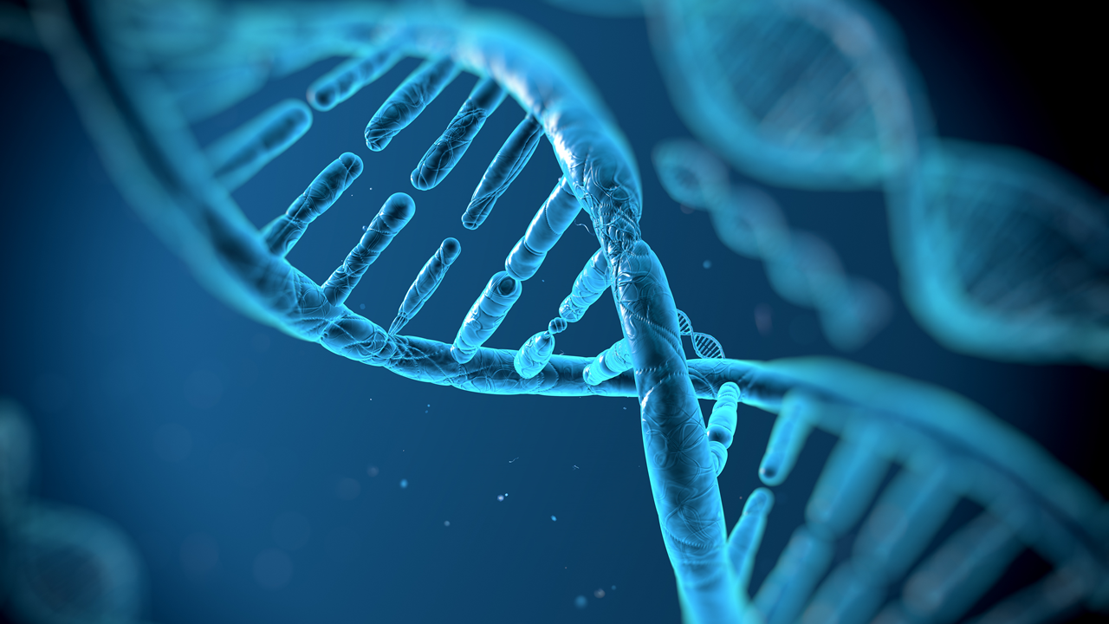
How do we know God exists?
Four proofs:
Nature
Testimony
The Bible
The Nation of Israel
Notes:
How do we know God exists?
God is a spirit. (Read John 4:24)
Explain wind analogy. (Ruach and Pneuma)
4 witnesses of God’s existence:
Nature - DNA code example
Testimony - changed lives, healed marriages, broken addictions, forgiveness, REAL CHANGE. (This is a great place to mention your personal story of deliverance or healing.)
The Bible - historical and prophetic accuracy
The Nation of Israel – Reborn after 2000 years of non-existence

Slide 5
Does God require blind faith?
Experience
Knowledge
Conscience
TRUTH
Notes:
Does God require blind faith?
No. God has given us a process to judge what is true.
Explain the process of judging truth:
Experience – firsthand.
Knowledge – others experience.
Conscience – is it right or wrong?
Where these three intersect is where we judge truth.
Our conscience makes us aware of God.
The Bible gives us knowledge of God.
When we respond to God, we experience the results in our lives.

Slide 6
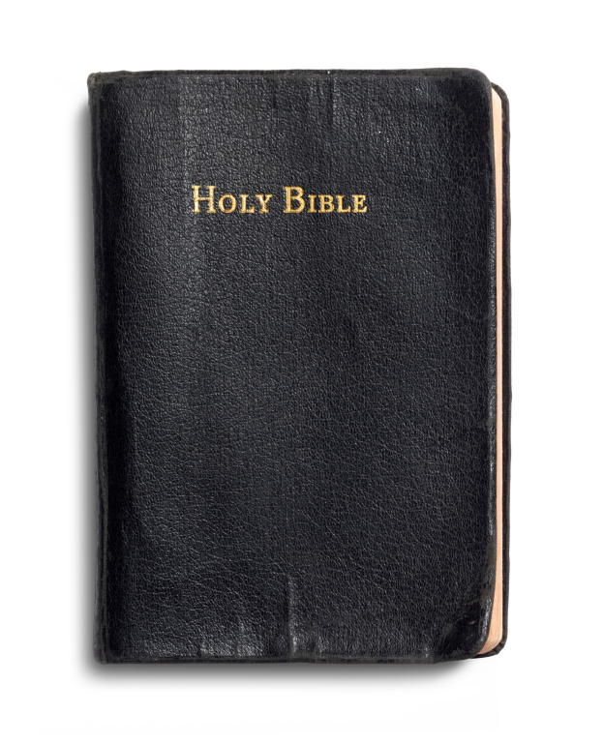
Is the Bible true?
Notes:
This is the question we must answer in life:
Do you believe the Bible is true?
People will tell you Bible is flawed, changed, altered, or irrelevant.
They are wrong…they don’t know the facts.

Slide 7

In order to be a disciple of Christ, we must believe the Bible is true and it is God’s message to us today.
Notes:
In order to be a disciple of Christ, we must believe the Bible is true and it is God’s message to us today.
You may even be skeptical yourself. That’s OK.
Let’s take a look at the facts and make an informed decision.
Where did the Bible come from?

Slide 8

The Bible is a collection of 66 books written by 44 writers under the inspiration of God.
Notes:
The Bible is a collection of 66 books written by 44 writers under the inspiration of God.
Written from 1500 BC to 96 AD.
Divided into an Old and New Testament or covenant. (agreement)
Inspiration means “In-Spirit”
READ: 2 Timothy 3:15-17 (pg.10)
READ: Galatians 1:11-12 (pg. 10)
Canon means “sacred collection”.
Early church leaders agreed on the 27 books of the NT
Explain the criteria used to select the books. (Apostolic authorship, church acceptance, non-contradictory)
That explains how the scriptures were determined, how did they physically get here?

Slide 9
Ancient sacred writings were carefully and accurately copied by scribes.
Notes:
Remember, there were no printing presses until the 15th century AD.
Ancient sacred writings were carefully and accurately copied by scribes.
It is important that we understand what a scribe is…

Slide 10
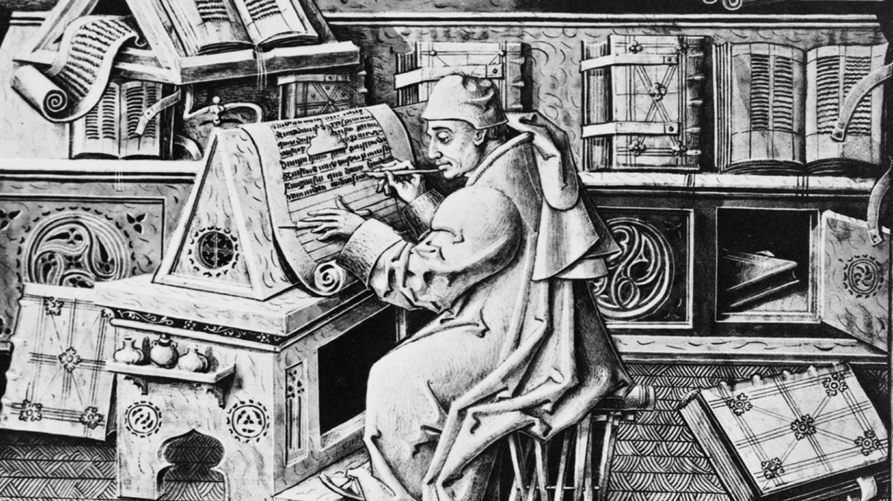
Notes:
A scribe was a person whose job was to copy sacred scrolls with accuracy and legibility.
The job was done by hand and by candlelight and was very tedious.
The work of a scribe was then checked for accuracy before the copy was considered complete.
This is how sacred scrolls were copied in the ancient world.
There are some discrepancies that have been discovered but they are minimal and well documented.
There was also the issue of languages…

Slide 11
The Old Testament was written in Hebrew, and the New Testament in Greek.
Notes:
The Old Testament was written mostly in Hebrew, and the New Testament in Greek.
There were three things that prevented people from being able to read the Bible:
Illiteracy or lack of translation – Couldn’t read Hebrew, Greek, or Latin.
Scarcity - No printing press for mass production.
Institutional Control – Bibles were costly and owned by the Catholic church.

Slide 12
The invention of the printing press and translation into common languages made the Bible accessible to millions.
Notes:
The invention of the printing press and translation into common languages made the Bible accessible to millions.
In the 1500’s William Tyndale translated the Bible into English.
He was strangled and burned at the stake.
John Gutenberg invented the printing press in 1450.
First version printed was the Latin Vulgate.

Slide 13
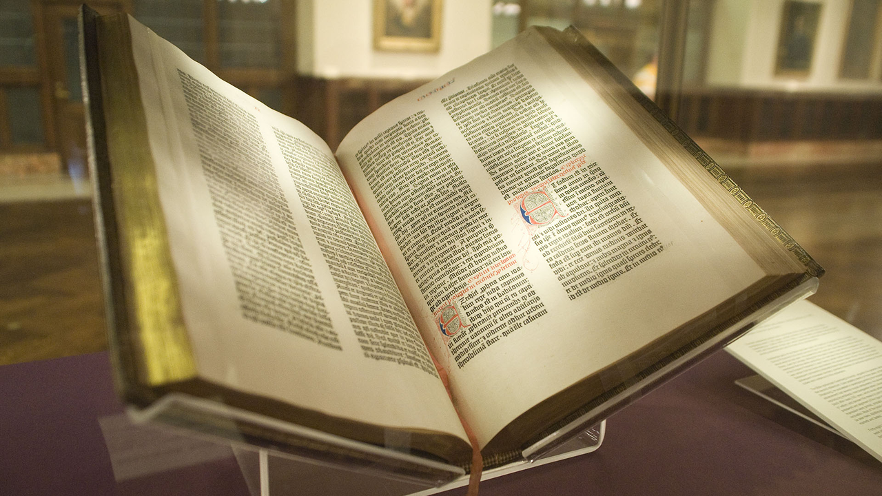
Notes:
This is a picture of one of the remaining rare Gutenberg Bibles. (Latin translation)
In 1611, the King James version of the Bible was completed.
The King of England (King James I) commissioned it’s translation.
The 1611 KJV was the predecessor of the modern Bible we use today.

Slide 14
It is important that you use a Bible translation you can understand and is translated accurately.
Notes:
It is important that you use a Bible translation you can understand and is translated accurately.
Do research to verify the source of the translation.
NLT, ESV, NIV are good translations to read and study.
Avoid “fad” translations that may be illegitimate.

Slide 15
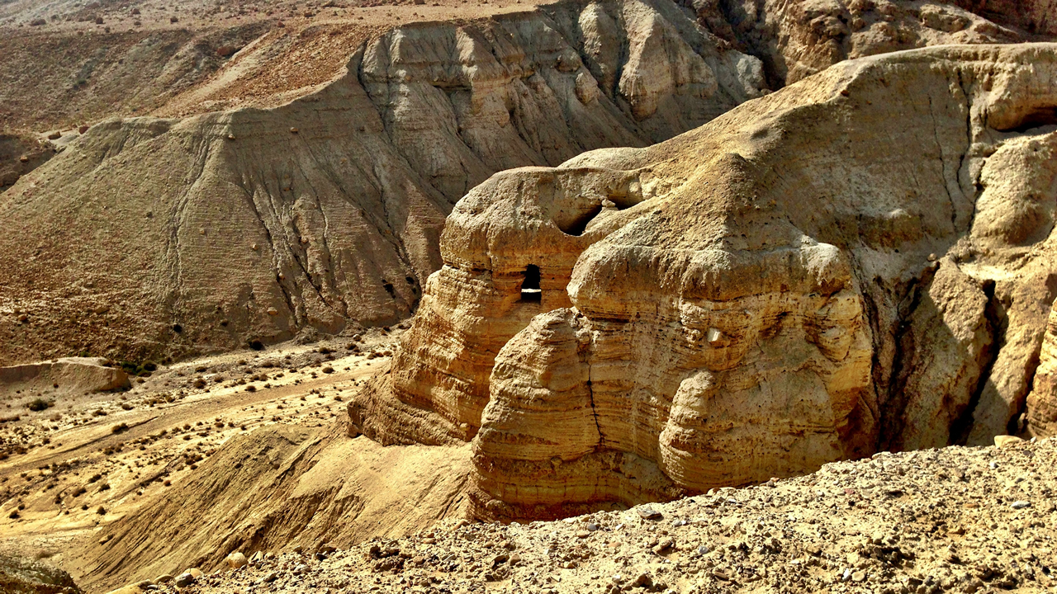
The Dead Sea Scrolls
Notes:
Explain the story of the Dead Sea Scrolls:
Found in 1946 in a cave in Qumran near the Dead Sea.
Previously, the earliest manuscript we had dated to the 1000 AD.
The Dead Sea Scrolls were 1000 years older!
They were virtually identical.
We have 28,000 manuscripts of the New Testament.
If someone tried to change it, if would have been discovered.
Considered one of the greatest archeological finds of modern times.

Slide 16
Considering the historical evidence, it is reasonable to believe the Bible is an accurate translation of the original writings and has been preserved through the ages of history.
Notes:
Considering the historical evidence, it is reasonable to believe the Bible is an accurate translation of the original writings and has been preserved through the ages of history.
Some people think the Bible contains a bunch of good stories that teach us about life but don’t really connect.
That’s not true either.

Slide 17
The Bible contains one story:
Jesus is the Son of God who came and died for our sins so we can receive eternal life if we follow Him.
Notes:
The Bible contains one story:
Jesus is the Son of God who came and died for our sins so we can receive eternal life if we follow Him.
There many characters and subplots, but this is the message of the entire Bible.
READ: John 3:16 (pg. 12)
READ: Mark 10:45 (pg. 12)
Let’s start our study in the first book of the Bible: Genesis.

Slide 18
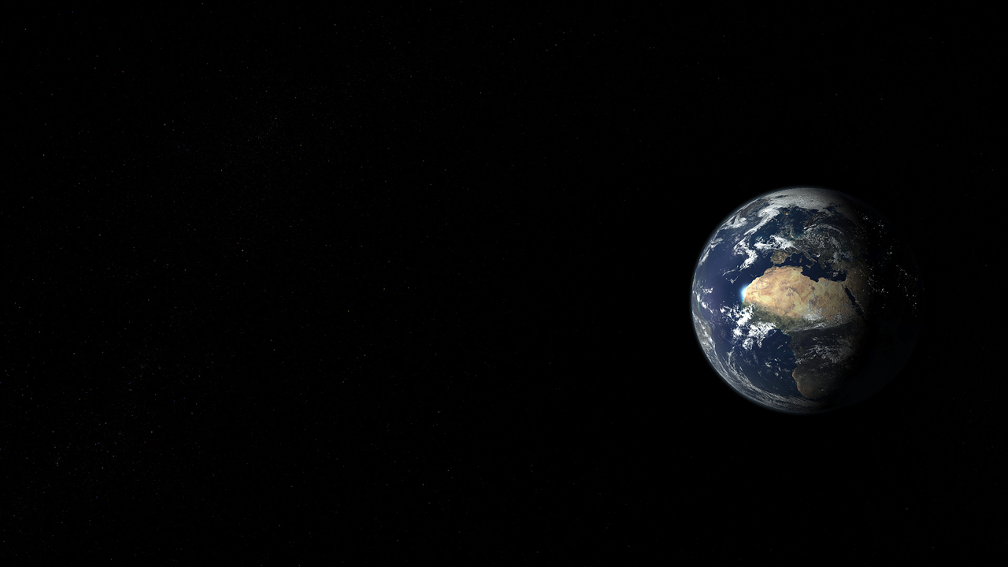
Genesis
Notes:
Genesis tells us about creation:
God created the universe in six days and rested on the seventh.
Explain how God created Adam:
Read: Genesis 2:7 (pg. 13)
Formed him from the dust. (body)
Breathed the breath of life into him. (spirit)
Man became a living soul.

Slide 19
Human beings are made of three distinct parts: body, soul, and spirit.
Notes:
Human beings are made of three distinct parts: body, soul, and spirit.
1 Thessalonians 5:23 (pg.14):
Now may the God of peace make you holy in every way, and may your whole spirit and soul and body be kept blameless until our Lord Jesus Christ comes again.
Let’s take a closer look at the relationship between the body, soul, and spirit.

Slide 20
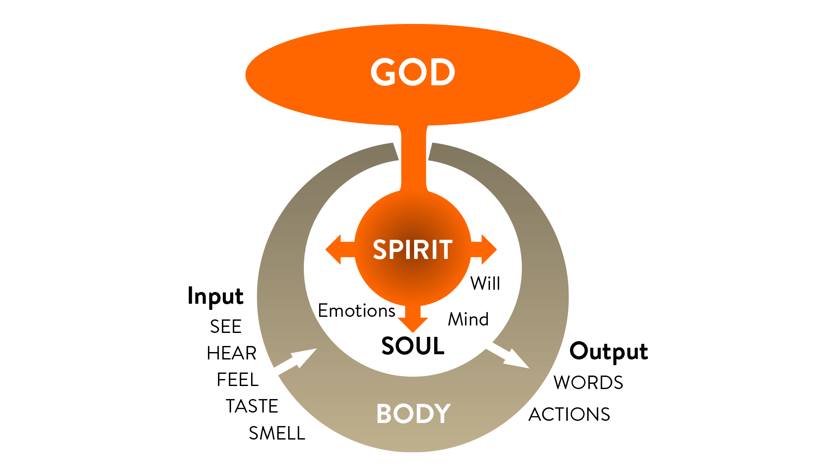
Notes:
Explain the spiritual man:
Body: skin, organs, blood, bone, etc.
Spirit: Your power source of life from God.
Soul: Where the body and spirit meet; thoughts, emotions, will. Your “inner man.”
Think of it as a computer:
Your body is the hardware,
The spirit is the electricity that powers it,
The soul is the software.
Death occurs when the spirit departs the body.
One no longer breaths. (breath of life)
Adam and Eve were created to live forever and in close fellowship with God.

Slide 21
Through Adam’s sin, death and decay entered into the human race and all creation.
Notes:
Something terrible happened in the garden of Eden.
Adam and Eve sinned. They disobeyed an explicit command of God.
Satan in the form of a serpent tempted Eve. (Explain)
Satan is a spirit and he is the enemy of God and His people here on Earth. (Fallen angel)
Through Adam’s sin, death and decay entered into the human race and all creation.
READ: Romans 8:20-21 (pg. 14)

Slide 22
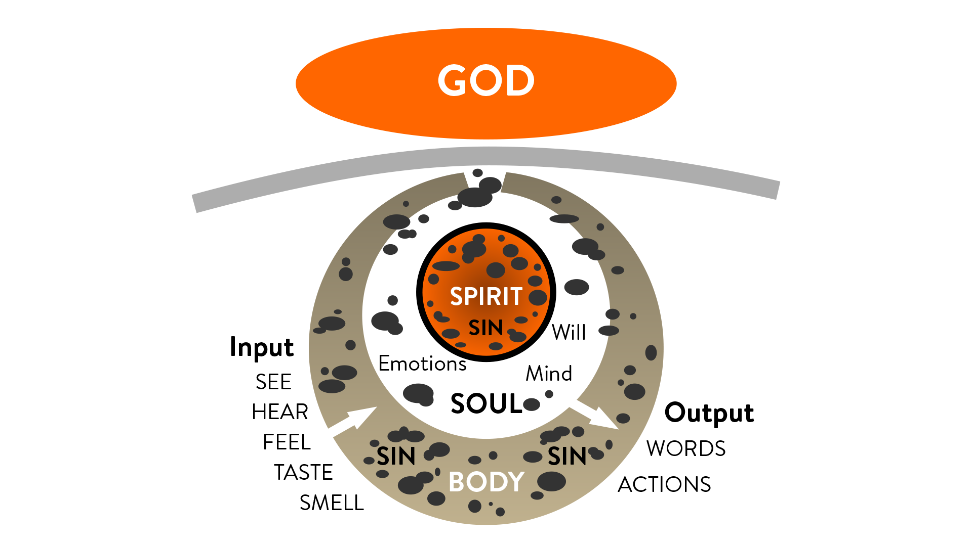
Notes:
Explain the effects sin had on Adam and Eve:
They were separated from God
They were now slaves to their sinful desires.
They began the process of aging and dying.
Sin is the root of all problems in the world today.
READ: Romans 5:12-21 (pg. 16)
So what is sin anyway?

Slide 23
Sin is any disobedience to God’s law or falling short of His righteousness, and the punishment for all sin is death.
Notes:
Sin is any disobedience to God’s law or falling short of His righteousness, and the punishment for all sin is death.
We have all sinned.
The Greek word for sin means “missed the mark”
We are born with sin from Adam. Explain inherited sin and committed sin.
The punishment for sin is death.
READ: 1 Corinthians 15:20-22 (pg. 16)
Hebrews 9:22 says “For without the shedding of blood, there is no forgiveness.”
The only way around this was to have someone else pay the price on our behalf…

Slide 24
Gods plan was to send His Son, Jesus Christ, to die as a substitute for our death.
Notes:
Gods plan was to send His Son, Jesus Christ, to die as a substitute for our death.
Christ did not come immediately, that was not God’s plan.
In the meantime, mankind became very wicked under the influence of their flesh and the devil.
God looked for faithful men that he could use to restore righteousness on the earth.
READ: Hebrews 11:1-16 (not in book)

Slide 25
God established the right to protect and bless men through righteousness by faith.
Notes:
God established the right to protect and bless men through righteousness by faith.
Cain killed Abel over sacrifices. This shows the struggle between good and evil.
The Earth became so wicked God decided to destroy it.
Explain the story of Noah and the Ark. (briefly)
8 people saved plus animals.
Several hundred years later God spoke to a man named Abraham…

Slide 26
God planned to create a nation from Abraham that would bless and teach other nations how to worship and serve God.
Notes:
God planned to create a nation from Abraham that would bless and teach other nations how to worship and serve God.
Abraham called out of Haran. Explain concept of separation.
God promised Abraham a son. Explain how Sarah was old and barren.
Ishmael born of Hagar. Explain how this was human effort.
Isaac born of Sarah. Explain how this was the son of promise.
God tests Abrahams faith by telling him to sacrifice Isaac. Explain how this is a foreshadowing of Christ.
Read: Genesis 22:13 (pg. 18)
Abraham had tremendous faith.
Abraham was called the “Father of the Faithful” (Galatians 3:7)

Slide 27
Faith is the key to living the Christian life.
Notes:
I want to pause here and say…
Faith is the key to living the Christian life.
Faith is when we believe what God’s Word says, even when it doesn’t appear to be possible, or we don’t understand it.
Simply put, faith is trusting God.
We trust God based on His character, not because we understand everything He does.
Hebrews 11:6 says “And it is impossible to please God without faith. Anyone who wants to come to him must believe that God exists and that he rewards those who sincerely seek him.”

Slide 28
God made a conditional covenant with Abraham to provide blessing and protection to his descendants.
Notes:
Because of Abrahams obedience and faith, God made a conditional covenant to provide blessing and protection to his descendants.
Read: Genesis 17:1-14 (not in book)
The nation of Israel exists today because of this covenant.
God keeps His promises!
Galatians 3:6 says that we are Abrahams children when we have faith in God.
Isaac had Jacob and Esau. Explain how the blessing went to the second born Jacob instead of the firstborn Esau. (Romans 5:15)
Jacob’s name was changed to Israel.
Israel had 12 sons. They became the tribes of Israel.
Joseph had a dream the world would bow down to him.
His brothers sold him into Egypt as a slave.
Joseph was imprisoned on false accusation.
Interpreted The King of Egypt’s dream.
Saved the world from famine.
Brought his family to Egypt.

Slide 29
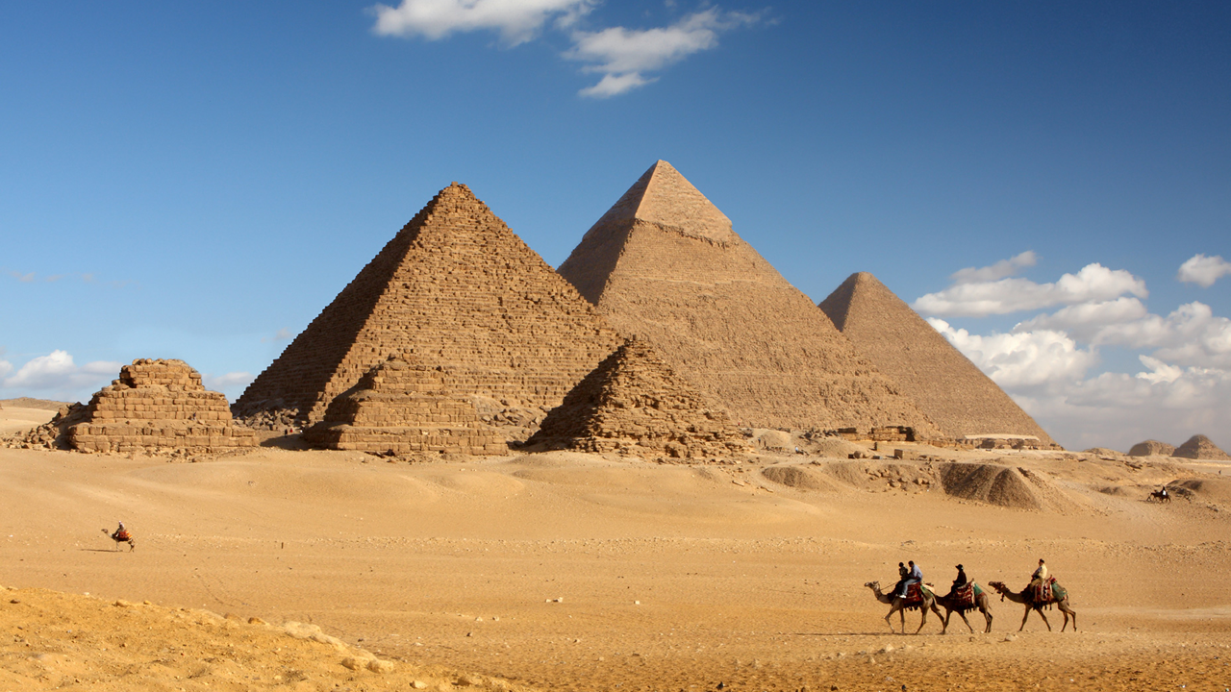
Pyramids of Giza, Egypt
Notes:
In closing, lets review what we learned today:
We looked at the four witnesses of God’s existence: Nature, Testimony, the Bible, The Nation of Israel.
The facts about the Bibles authenticity.
Sin is the reason that we need a Savior.
Faith, or trust, is the first step to please God. (Abraham)
How Israel ended up in Egypt. (Joseph)
In our next lesson, we will learn how God revealed His plan to save us through Moses and the nation of Israel.

Slide 30
Notes:
Questions or comments?
Ask each student to do the following before the next lesson:
Read Lesson 1 in the book again.
Spend 30 minutes alone praying. Ask God to lead you and guide you on your quest to find truth.

